Slide 2
Axial-mode wire helix
Antenna 3 : Results

Slide 3
Axial-mode wire helix
Antenna 3 : sketches, objectives and parameters

Slide 4
Antenna Structure: Antenna Parameters
Name | Description
f₀ | Centre frequency
Dw | Wire diameter
Dg | Diameter of the ground plane
Dh | Diameter of the helix
h | Handedness
Hf | Height of the feed-point
N | Number of helix turns
φ | Pitch angle of the helix
X | Device X-dimension
Y | Device Y-dimension

Slide 5
Antenna Structure: Antenna Parameters (2)
Name | Description
Z | Device Z-dimension
Lw | Total wire length

Slide 6
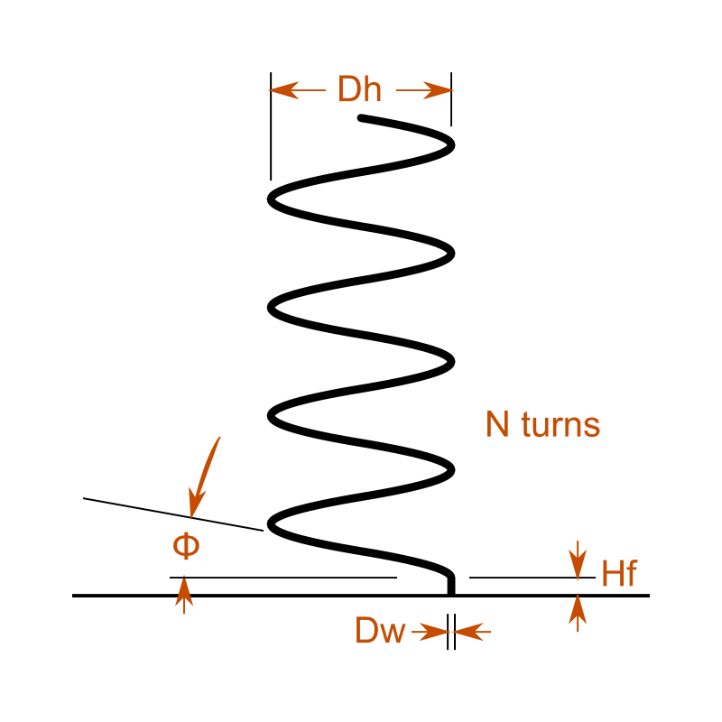
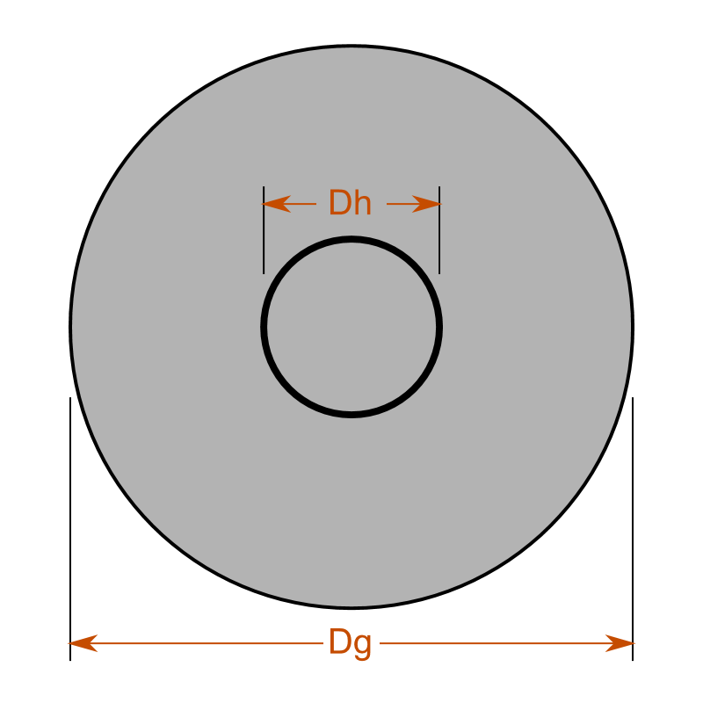
Sketches
Side view
Top view

Slide 7
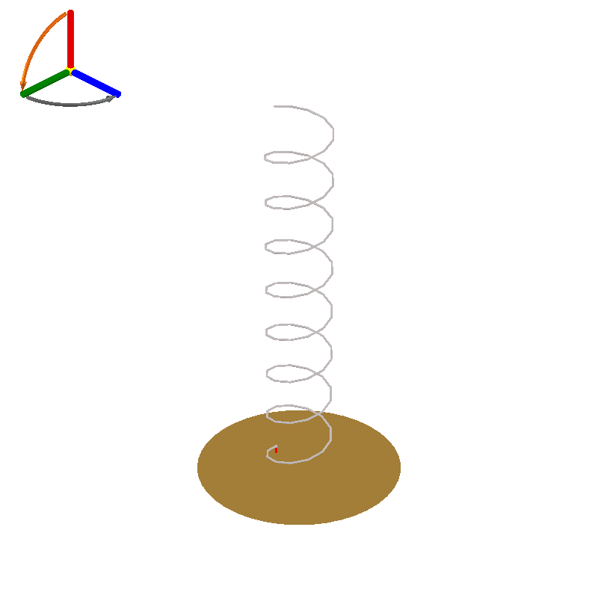
Snapshot 1: Preview

Slide 8
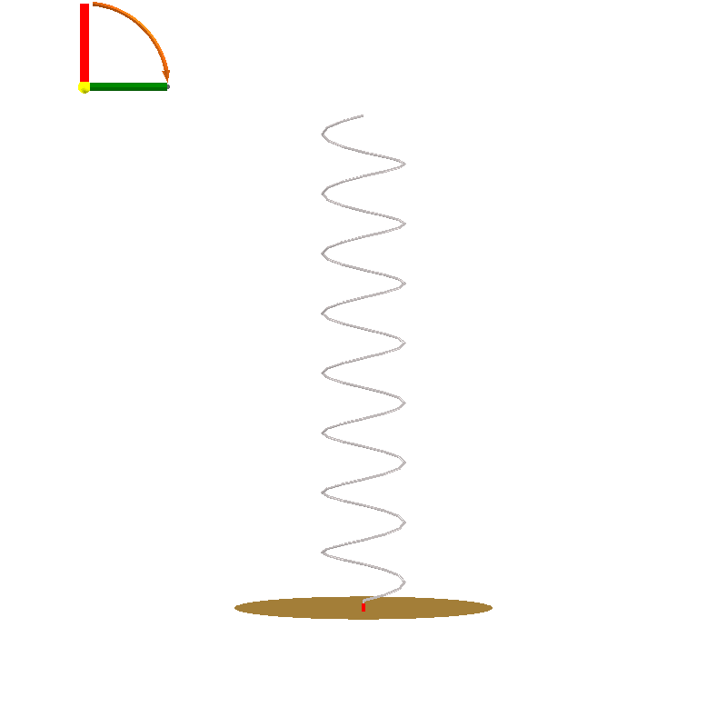
Snapshot 1: Front Side Preview

Slide 9
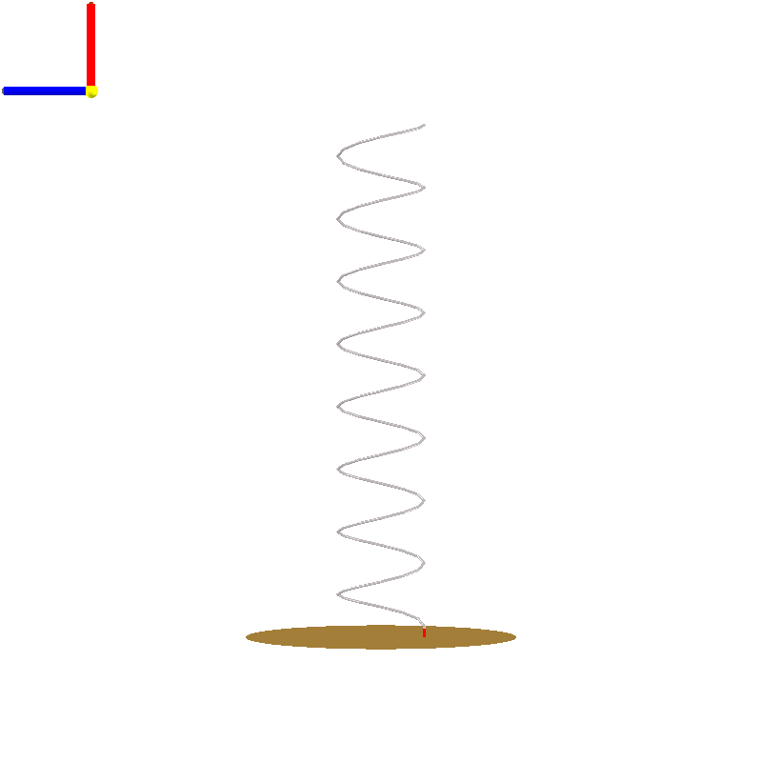
Snapshot 1: Left Side Preview

Slide 10
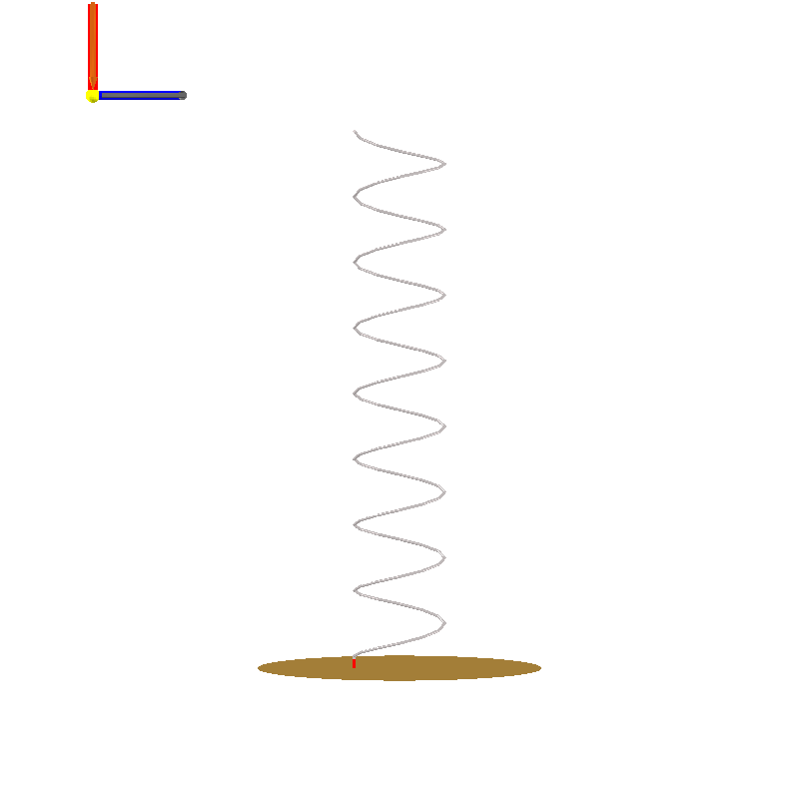
Snapshot 1: Right Side Preview

Slide 11
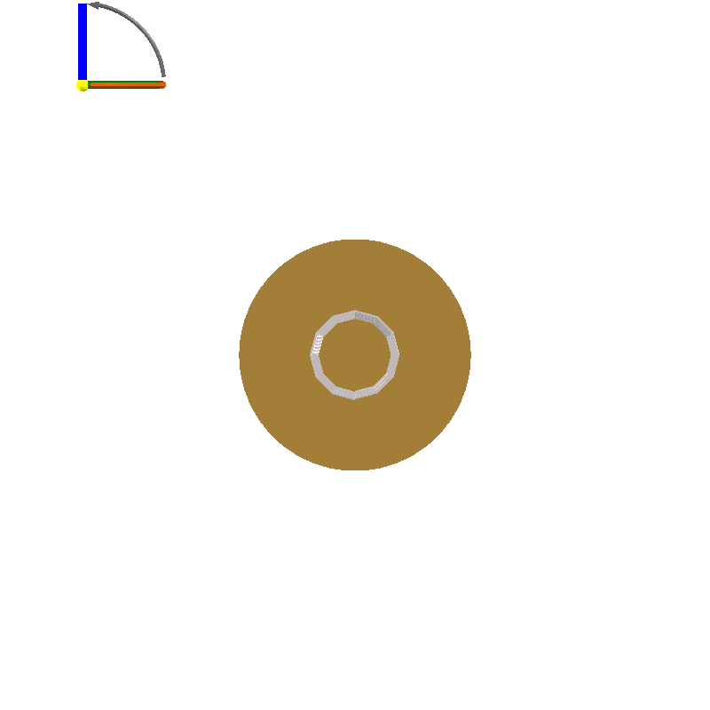
Snapshot 1: Top Side Preview

Slide 12
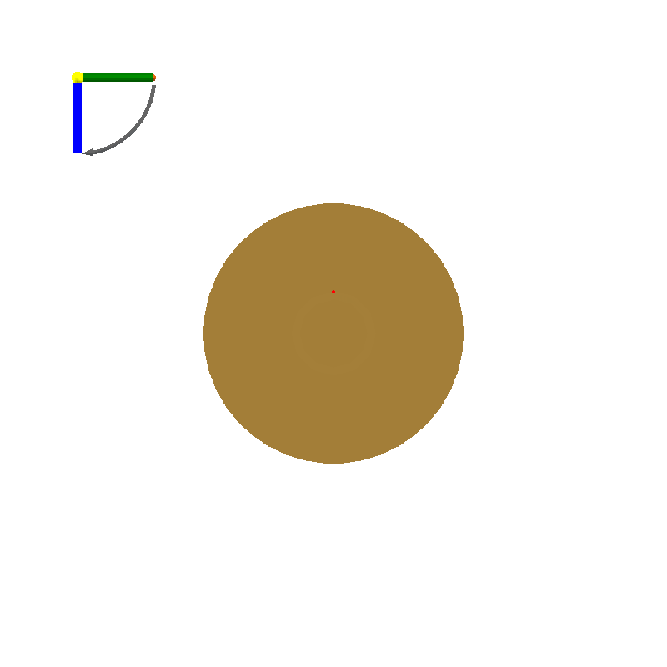
Snapshot 1: Bottom Side Preview

Slide 13
Snapshot 1: Design Objectives
Objective Group: gain and wire diameter
Name | Description | Value
f₀ | Centre frequency | 2.4 GHz
Dw | The desired wire diameter | 1.249 mm
G | Gain | 13 dBi
P | Polarisation (transmitting) | RHC

Slide 14
Snapshot 1: Physical Parameters
Name | Description | Value
Dw | Wire diameter | 1.249 mm
Dg | Diameter of the ground plane | 124.9 mm
Dh | Diameter of the helix | 39.76 mm
h | Handedness | Right
Hf | Height of the feed-point | 4.997 mm
N | Number of helix turns | 8
φ | Pitch angle of the helix | 13 °

Slide 15
Snapshot 1: Derived Quantities
Name | Description | Value
X | Device X-dimension | 39.76 mm
Y | Device Y-dimension | 39.76 mm
Z | Device Z-dimension | 235.7 mm
Lw | Total wire length | 1.026 m

Slide 16
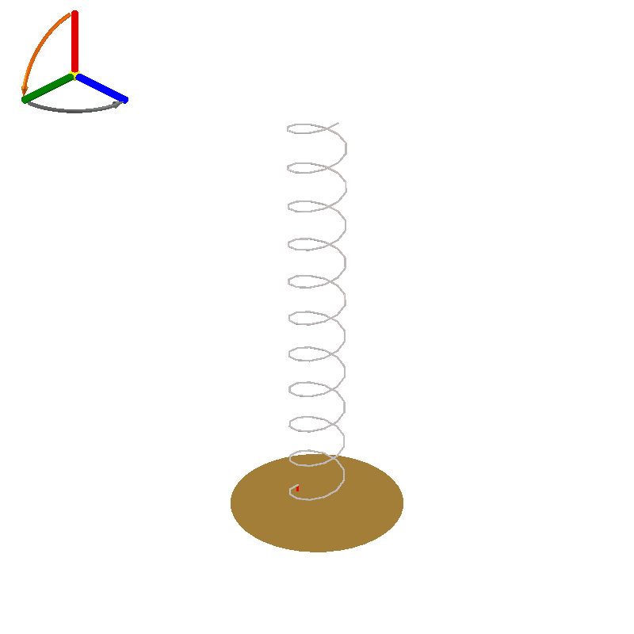
Design 1: Preview

Slide 17
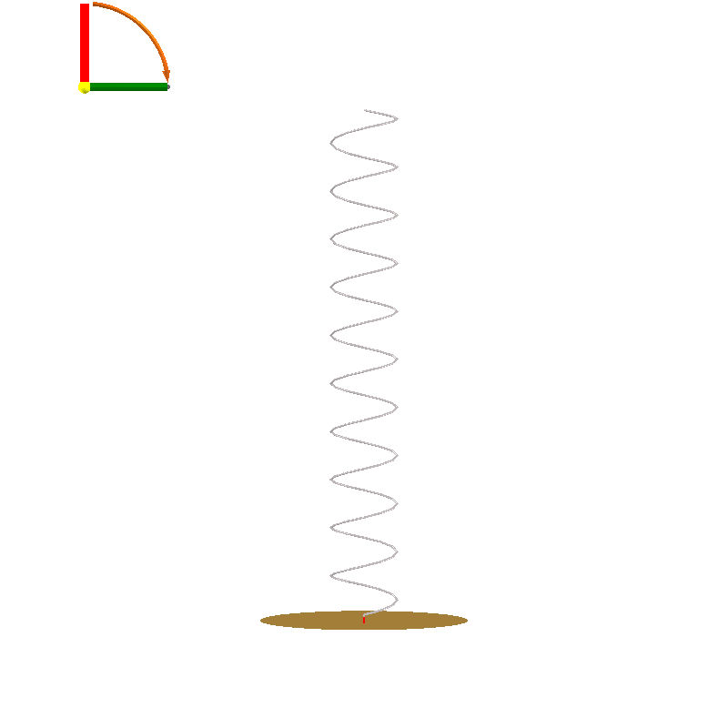
Design 1: Front Side Preview

Slide 18
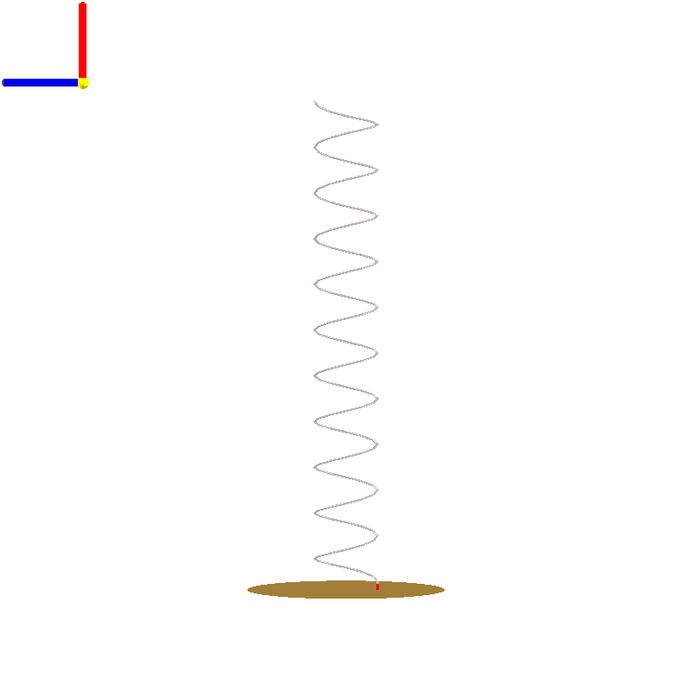
Design 1: Left Side Preview

Slide 19
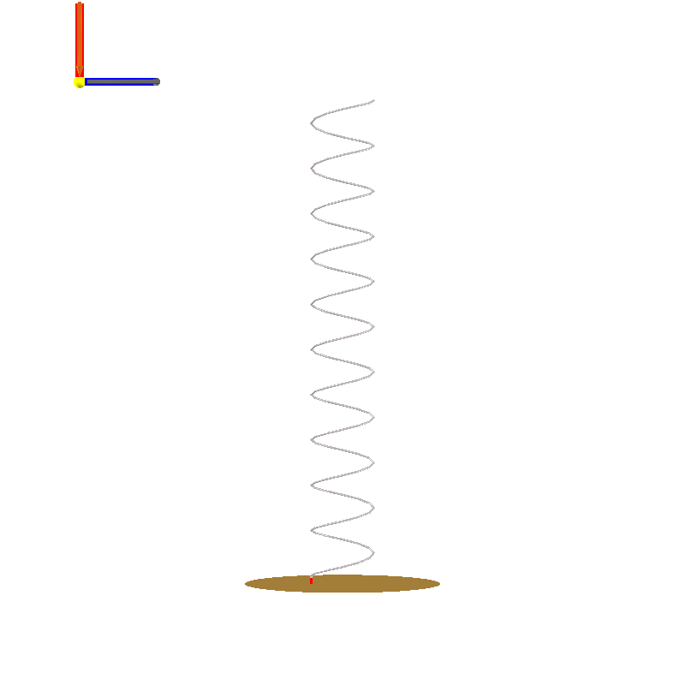
Design 1: Right Side Preview

Slide 20
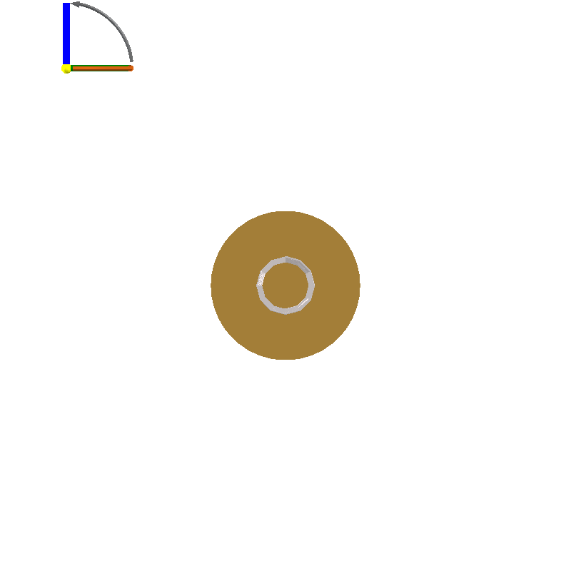
Design 1: Top Side Preview

Slide 21
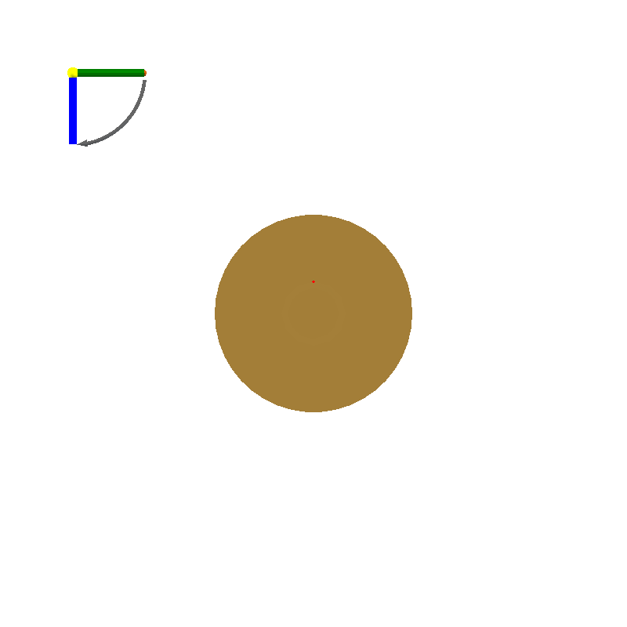
Design 1: Bottom Side Preview

Slide 22
Design 1: Design Objectives
Objective Group: beamwidth and wire diameter
Name | Description | Value
f₀ | Centre frequency | 2.4 GHz
Dw | The desired wire diameter | 1.249 mm
bw | 3dB beamwidth | 45 °
P | Polarisation (transmitting) | RHC

Slide 23
Design 1: Physical Parameters
Name | Description | Value
Dw | Wire diameter | 1.291 mm
Dg | Diameter of the ground plane | 124.9 mm
Dh | Diameter of the helix | 39.76 mm
h | Handedness | Right
Hf | Height of the feed-point | 4.997 mm
N | Number of helix turns | 10.5
φ | Pitch angle of the helix | 13 °

Slide 24
Design 1: Derived Quantities
Name | Description | Value
X | Device X-dimension | 39.76 mm
Y | Device Y-dimension | 39.76 mm
Z | Device Z-dimension | 307.8 mm
Lw | Total wire length | 1.346 m

Slide 25
Axial-mode wire helix
Antenna 3 : estimated performance charts

Slide 26
Impedance vs Frequency

Slide 27
Impedance vs Frequency

Slide 28
Impedance vs Frequency
Reflection coefficient (20log|Γ|)
 | Design 1
Reference impedance @ port 1 | (140+0j) Ω

Slide 29
Impedance vs Frequency

Slide 30
Impedance vs Frequency
VSWR
 | Design 1
Reference impedance @ port 1 | (140+0j) Ω

Slide 31
Far Field vs Angle @ f0

Slide 32
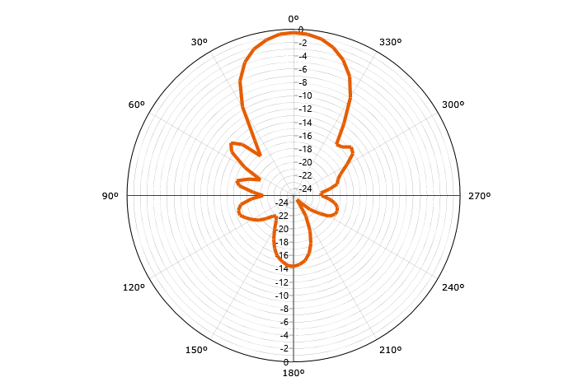
Far Field vs Angle @ f0
Gain (Total - normalised)

Slide 33
Far Field vs Angle @ f0

Slide 34
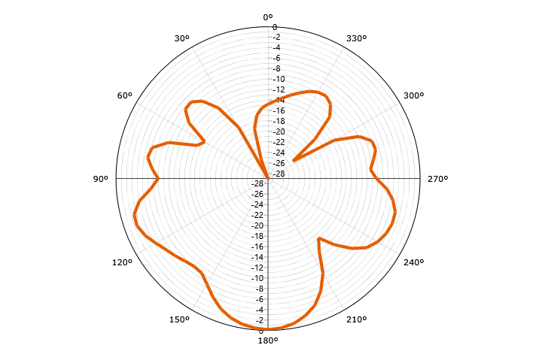
Far Field vs Angle @ f0
Gain (LHC - normalised)

Slide 35
Far Field vs Angle @ f0

Slide 36
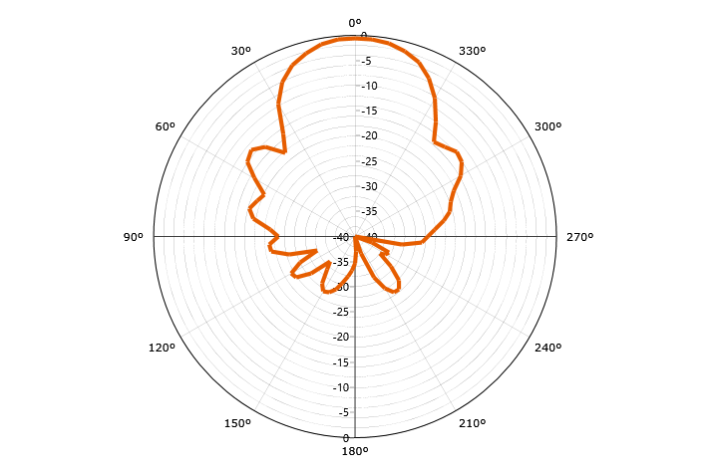
Far Field vs Angle @ f0
Gain (RHC - normalised)

Slide 37
Far Field vs Angle @ f0

Slide 38
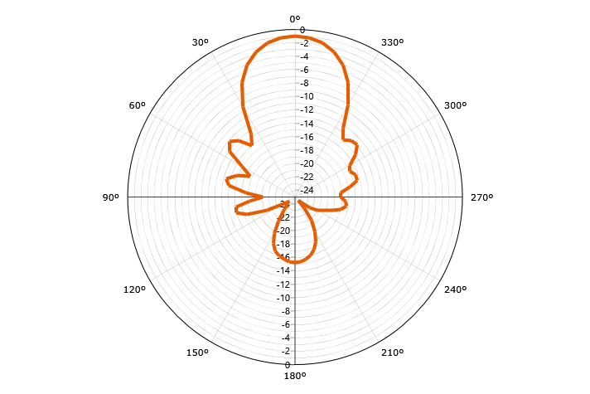
Far Field vs Angle @ f0
Gain (Horizontal - normalised)

Slide 39
Far Field vs Angle @ f0

Slide 40
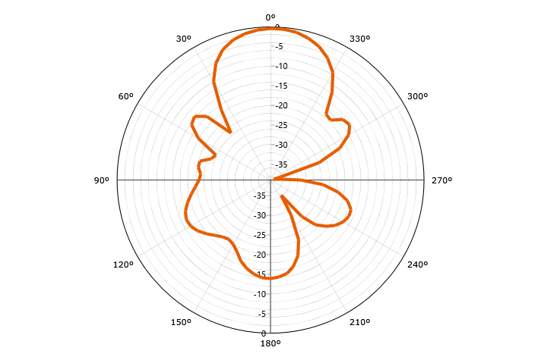
Far Field vs Angle @ f0
Gain (Vertical - normalised)

Slide 41
Far Field vs Angle @ f0

Slide 42
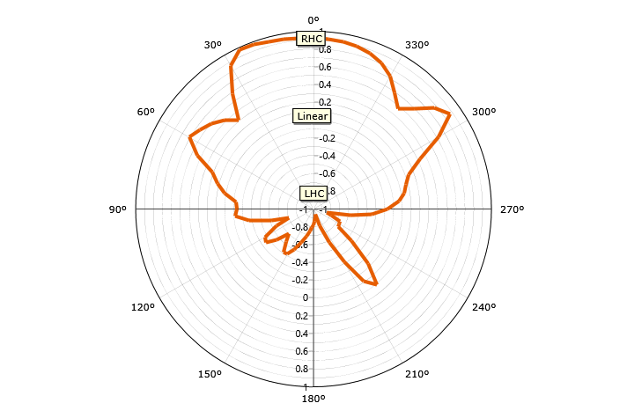
Far Field vs Angle @ f0
Axial Ratio (Handed)

Slide 43
Far Field vs Angle @ f0

Slide 44
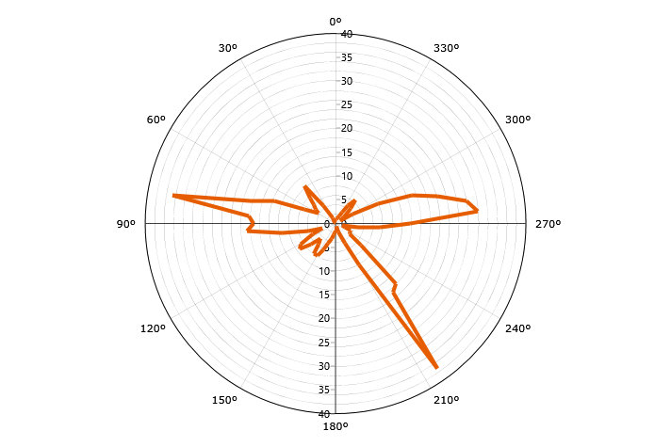
Far Field vs Angle @ f0
Axial Ratio (IEEE)

Slide 45
Far Field vs Angle @ f0

Slide 46

Far Field vs Angle @ f0
Ludwig III (Co)

Slide 47
Far Field vs Angle @ f0

Slide 48

Far Field vs Angle @ f0
Ludwig III (Cross)

Slide 49
Far Field vs Frequency

Slide 50
Far Field vs Frequency

Slide 51
Far Field vs Frequency

Slide 52
Far Field vs Frequency

Slide 53
Far Field vs Frequency

Slide 54
Far Field vs Frequency

Slide 55
Far Field vs Frequency

Slide 56
Far Field vs Frequency

Slide 57
Far Field vs Frequency

